Slide 1

Work In Progress
The British College
Project Management
Team Members:
Hemanta Bikram Singh
Diwakar Darlami
Ayush Bajgai
Rabin Balayar
Arbindra Kumar Sah

Slide 2
Table of Content
Introduction
ERD/EERD/Composite ERD
UML
Customer Interface
Trader Interface
Management Interface
Functional Requirements
Non-functional Requirements
Timeline
Work Breakdown Structure
Product Progression
Conclusion

Slide 3

Introduction
An online marketplace
Name: CleckShop
Location: suburbs of Cleckhuddersfax
Website: www.cleckshop.com

Slide 4
Introduction
Tools:
Html/Css (bootstrap) - frontend
Php – for crud operation
Oracle – For backend
OCI connection to connect frontend with backend

Slide 5
Introduction
3 users
Customer
Trader
Admin

Slide 6
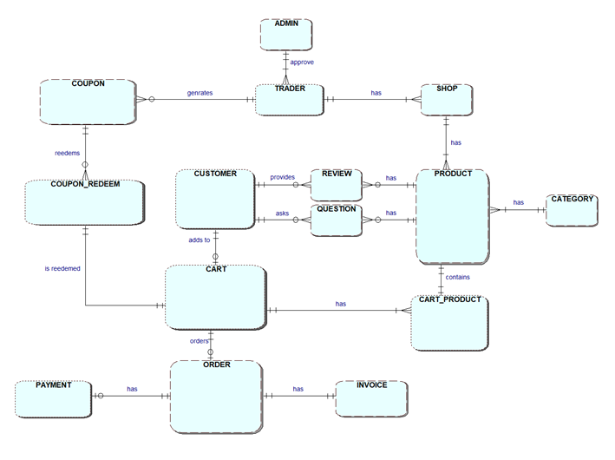
ERD
No. of entity: 15
Link entity: 2 - COUPON_REDEEM - CART_PRODUCT

Slide 7
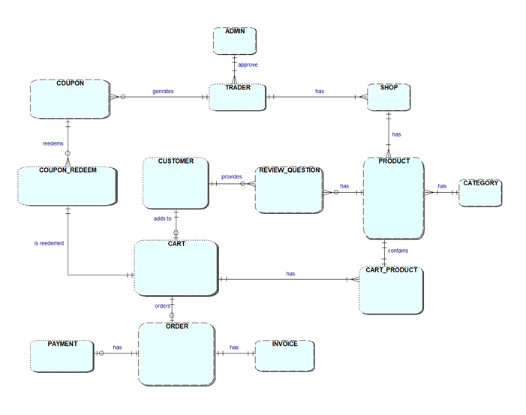
Composite ERD

Slide 8
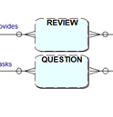
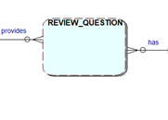
Composite ERD
REVIEW [customer_id (fk), product_id(fk)]
QUESTION [customer_id (fk), product_id(fk)]
REVIEW_QUESTION [customer_id (fk),
product_id(fk)]

Slide 9
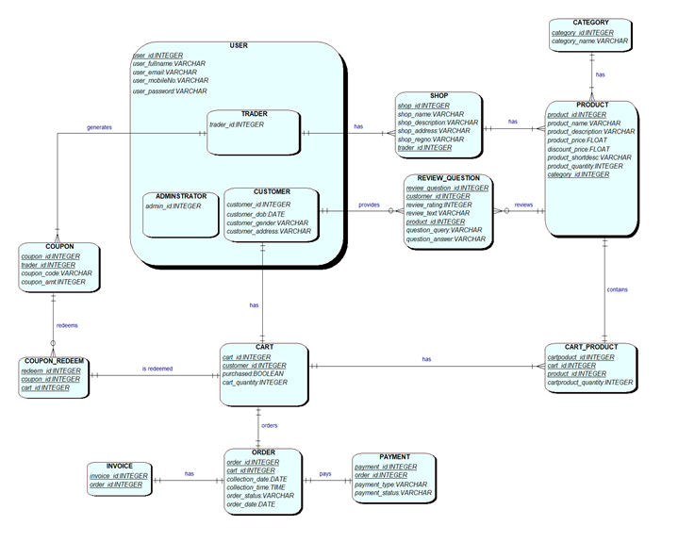
EERD

Slide 10
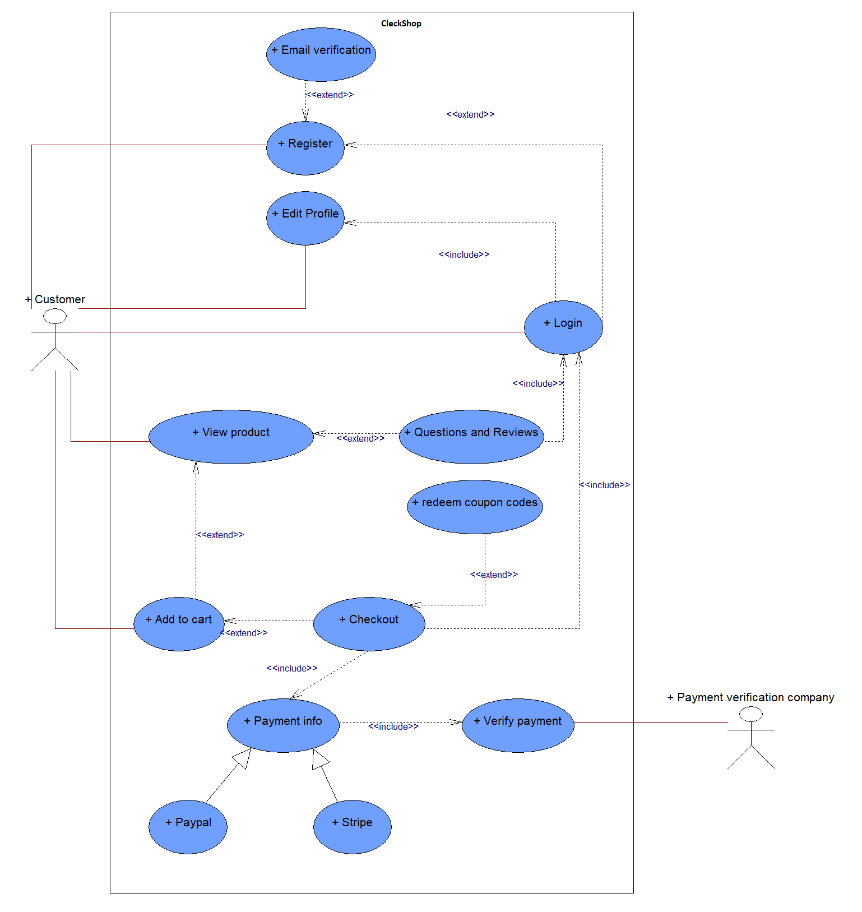
Customer UML

Slide 11
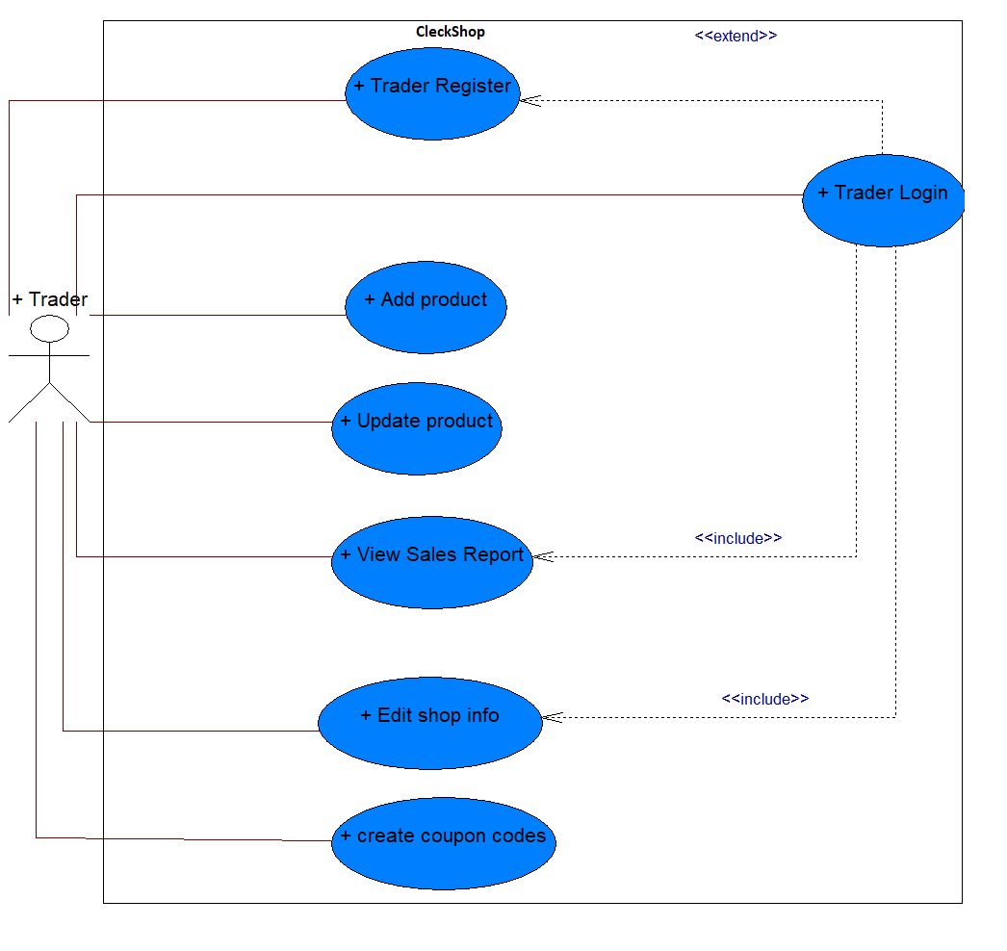
Trader UML

Slide 12
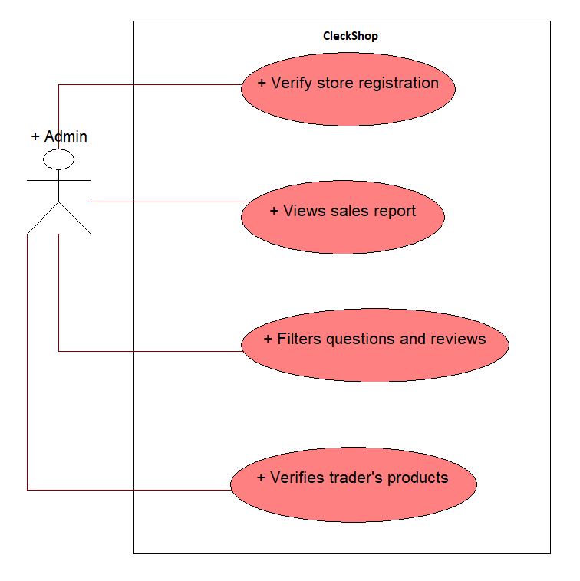
Admin UML

Slide 13
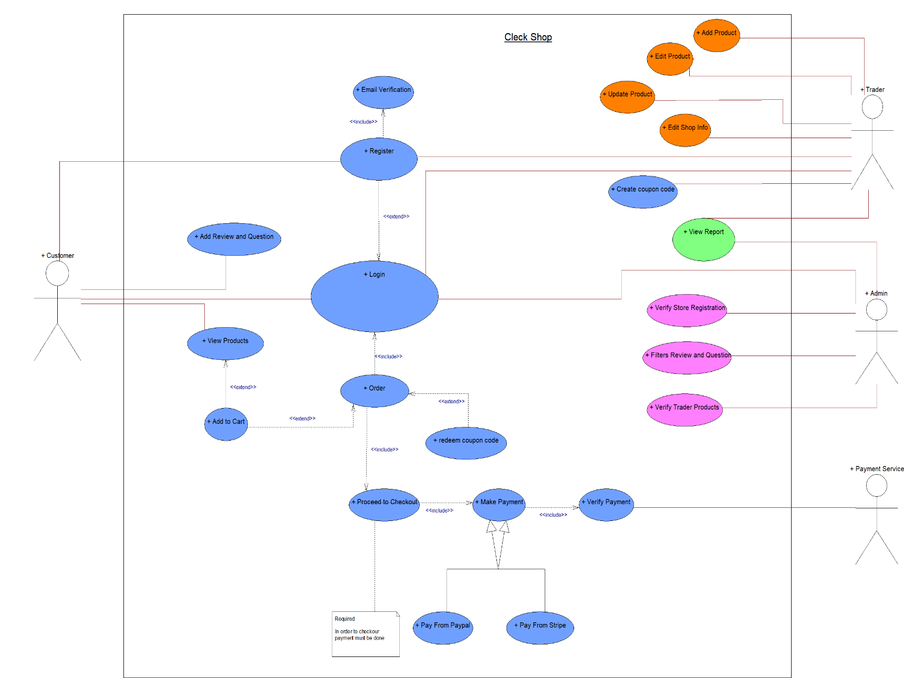
Overall UML

Slide 14
Customer Interface

Slide 15
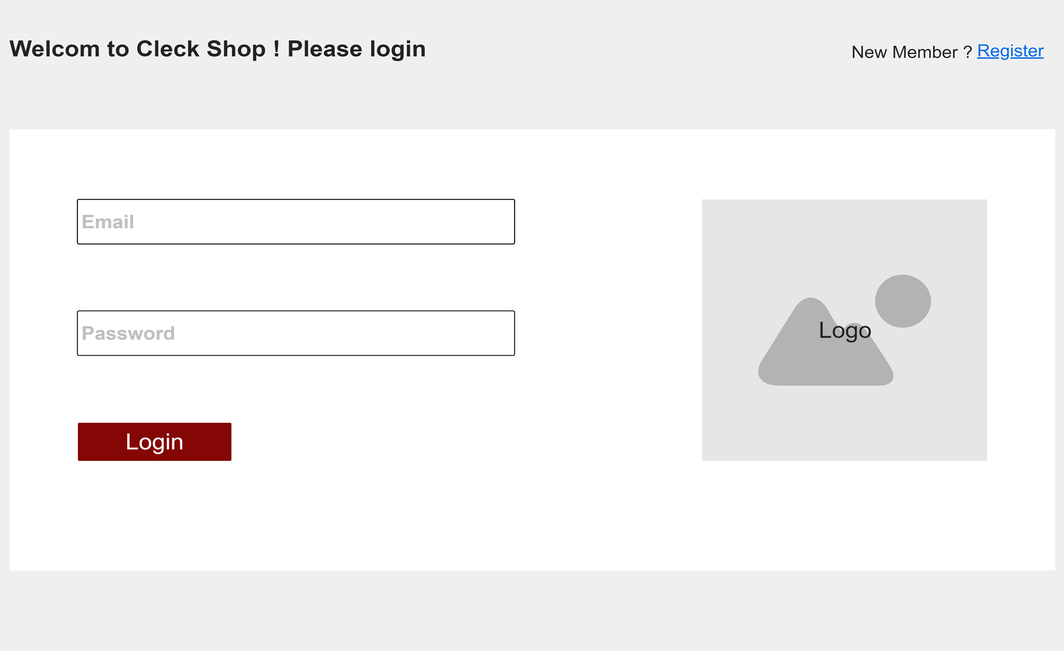
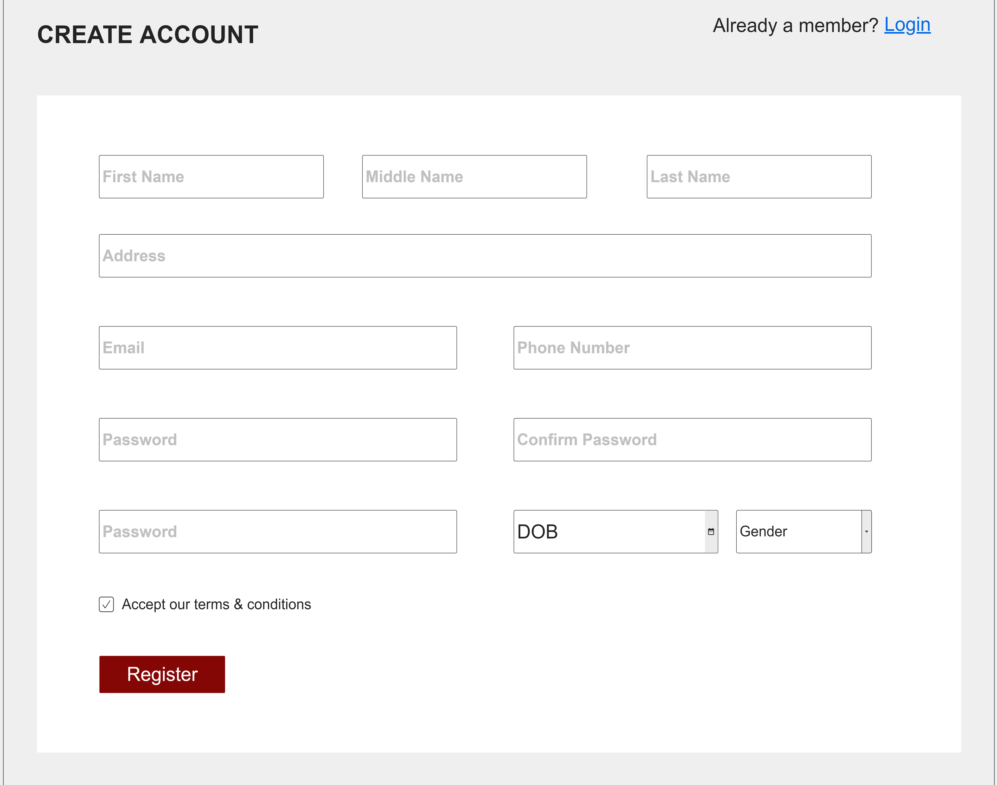
Customer Interface
LOGIN
REGISTER

Slide 16
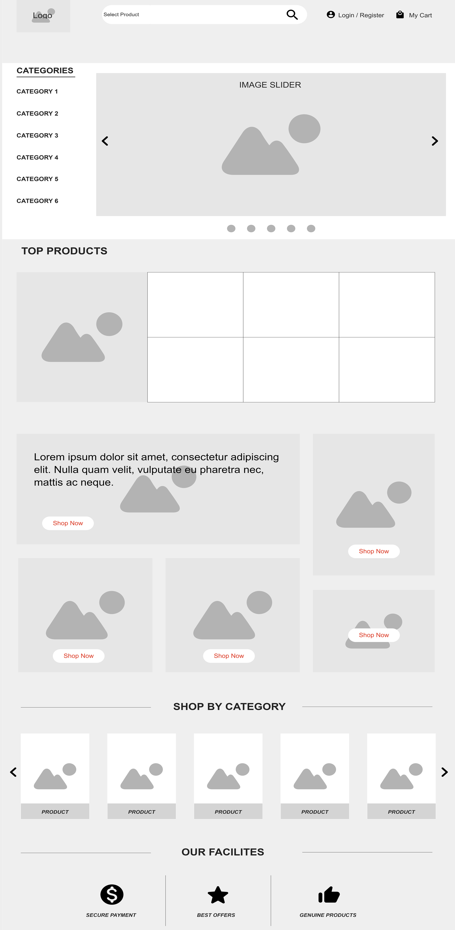
Customer Interface
HOMEPAGE
Easy to view and browse
Search
Provides all categories
Direct access to cart

Slide 17
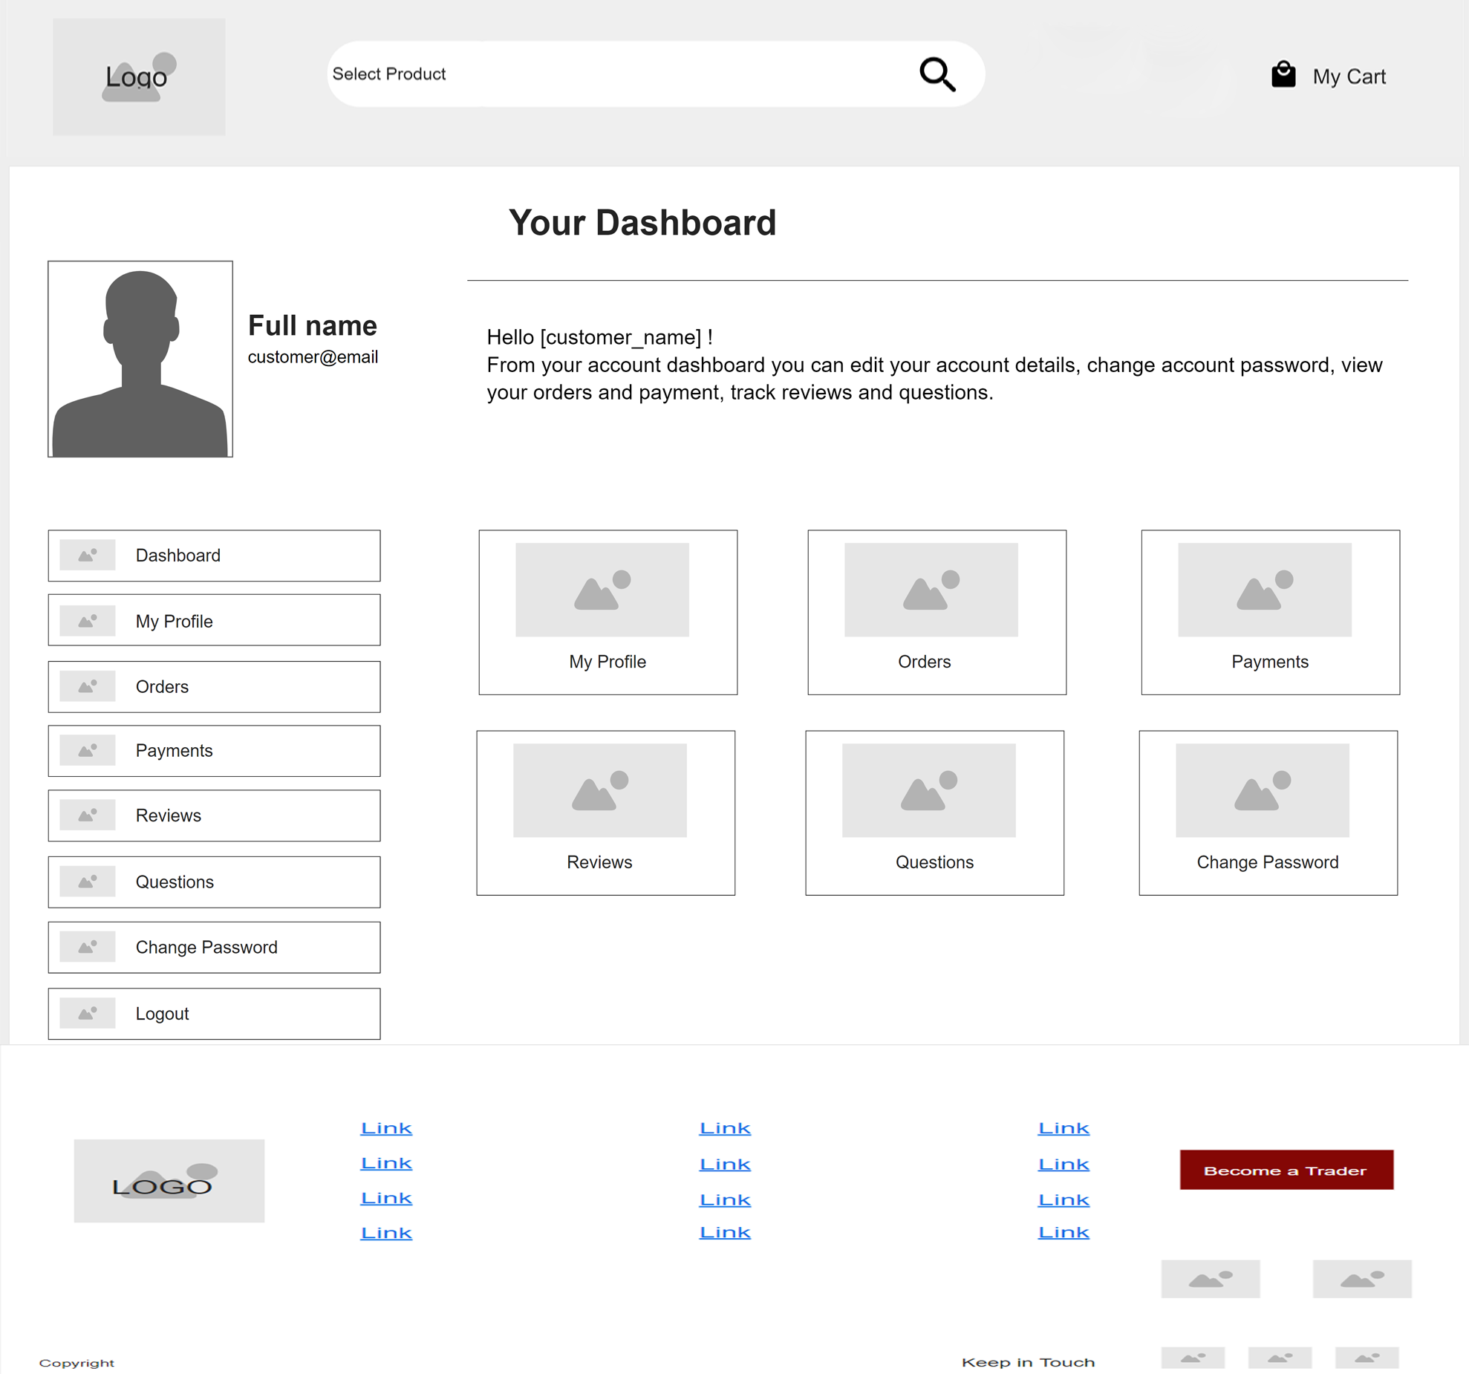
Customer Interface
CUSTOMER PROFILE
Simple and easy
Easily accessible
Provides various information

Slide 18
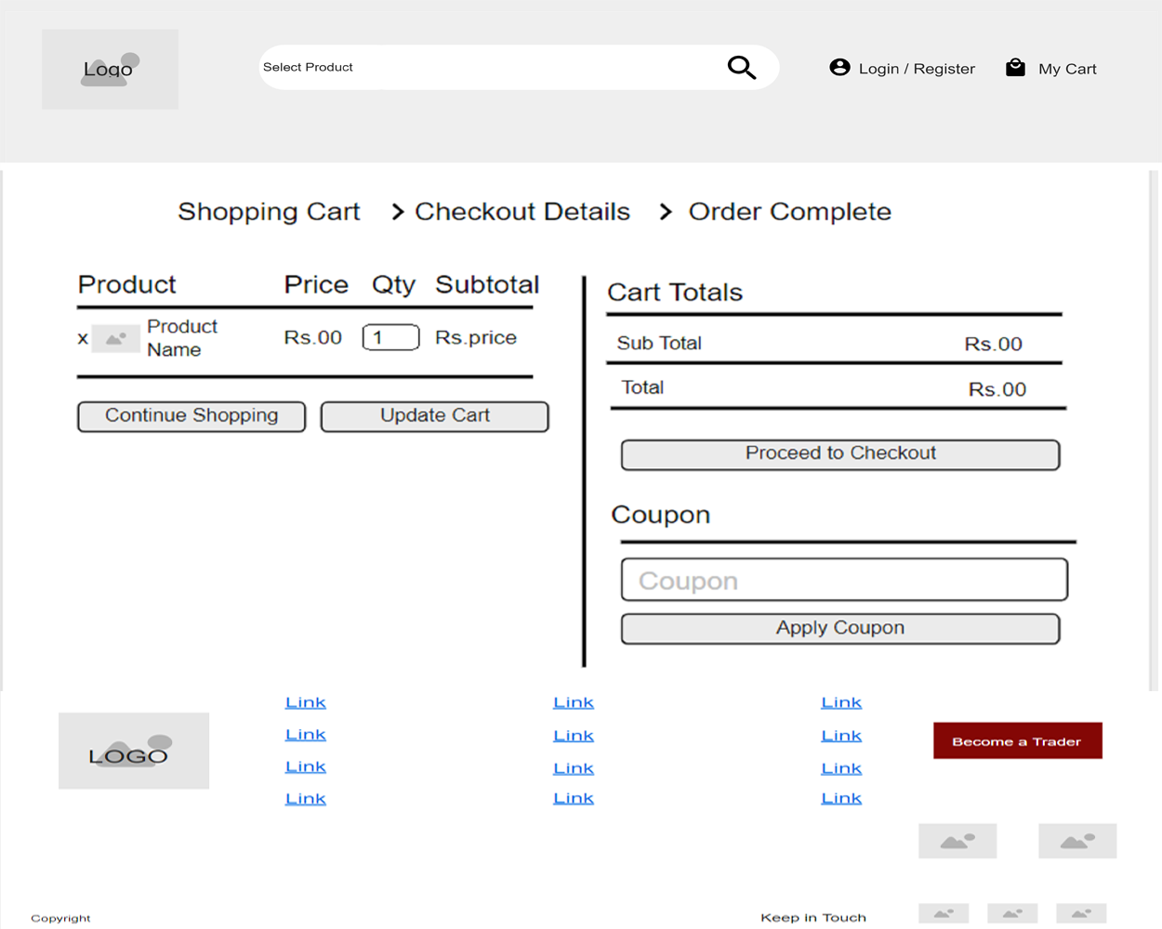
Customer Interface
CART
Simple and easy
Update cart
Apply Coupons
Maximum of 20 items

Slide 19
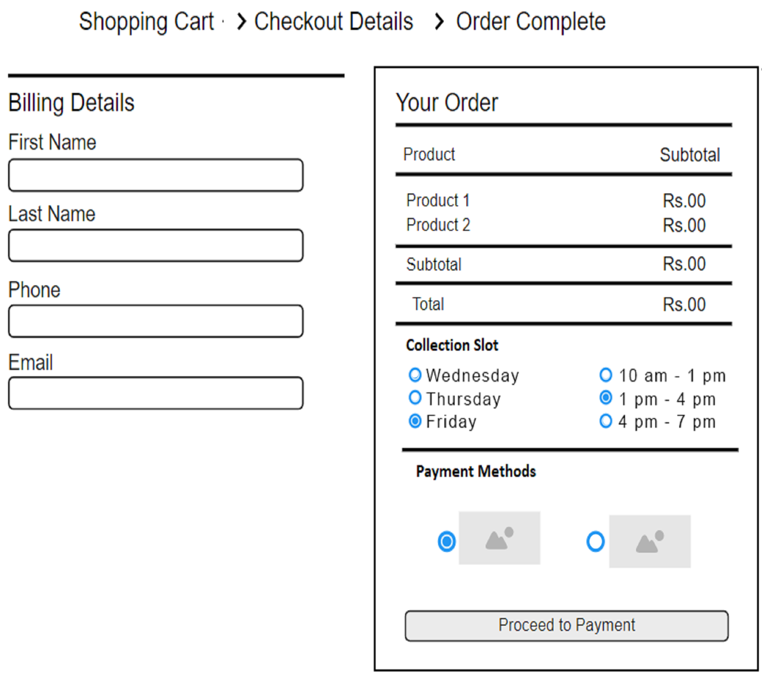
Customer Interface
CHECKOUT
Customer Details
Easy Invoice
Collection Slot
Payment methods
Pay-pal
Stripe

Slide 20
Trader and Admin
Interface

Slide 21
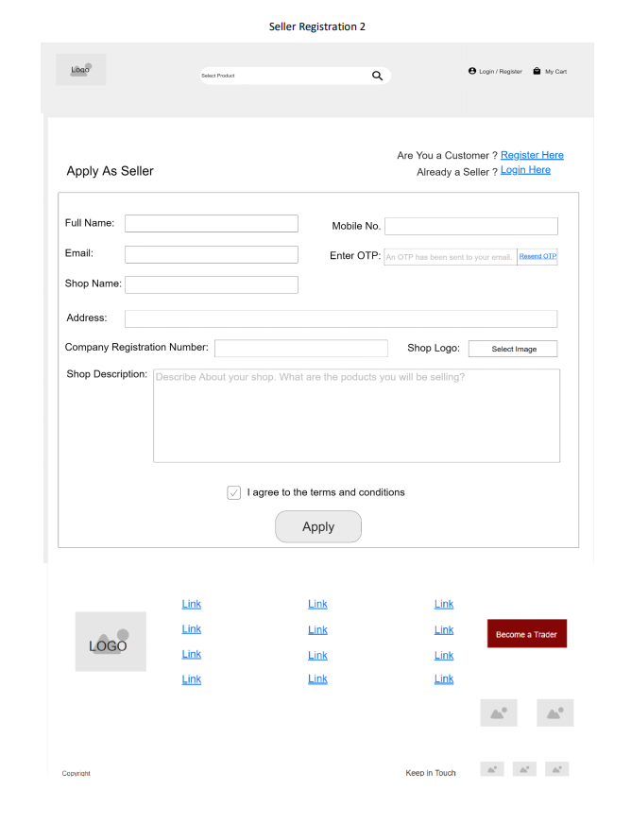
Trader Interface
Trader Registration
Separate login panel.
Different login credentials .
Must fill their basic information.
Traders' information is validated.
Must agree to Terms and Conditions of The CleckShop

Slide 22
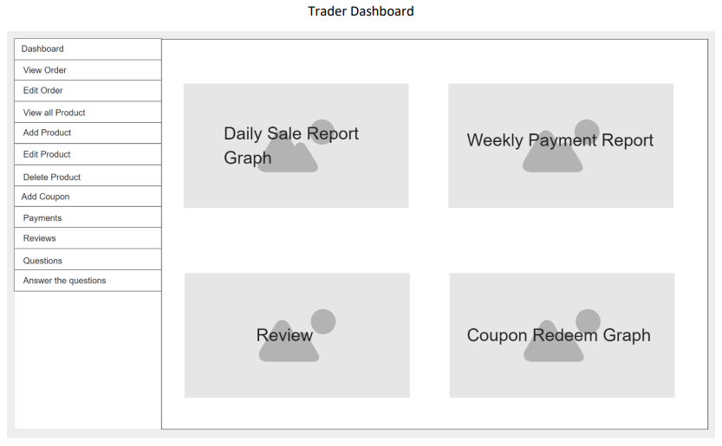
Trader Interface
Trader Dashboard
Login to Oracle dashboard to view orders and stock availability.
Able to see sales reports.
Can update their information.
Able to perform CRUD operation on their products.
Coupons and discount on relevant products.
Respond to client questions.

Slide 23
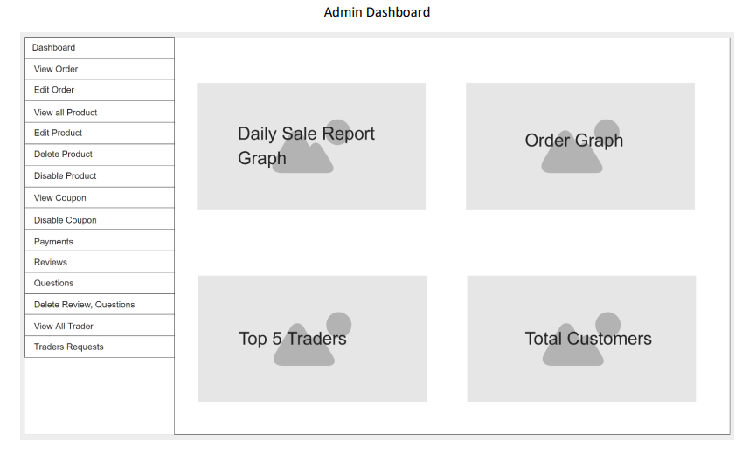
Admin Interface
Admin Dashboard
Oracle dashboard to view report of Traders.
View Top 5 Traders.
View an order graph.
View the payment info.

Slide 24
Admin Role
Admin have the permission to approve the Trader requests.
Customers' unfavorable comments can be deleted by the administrator.
Admin can disable coupons.
If the product appears to be identical, the administrator can disable it.

Slide 25
Functional and Non-Functional
Requirements

Slide 26
Functional Requirements
Products
All Products should have details
Interface to view products

Slide 27
Functional Requirements
Customer
Customer should have details
Dashboard and Registered Customer
Registration System
Order and Cart System
Checkout and payment System

Slide 28
Functional Requirements
Trader
Admin
Login and Register
Dashboard
Payments
Login System
Admin Role
Dashboard

Slide 29
Non-Functional Requirements
Capacity
Performance
Security
Reliability, Availability, Maintainability
Data Integrity
Responsiveness

Slide 30
Timeline and Work Breakdown Structure

Slide 31
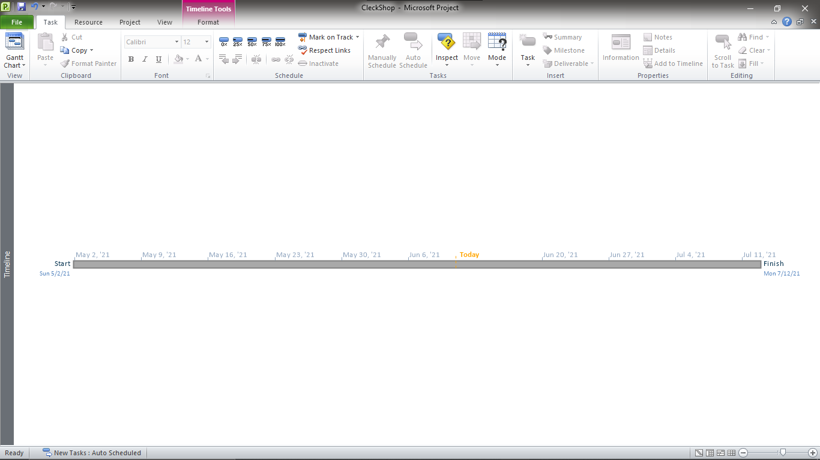
Timeline

Slide 32
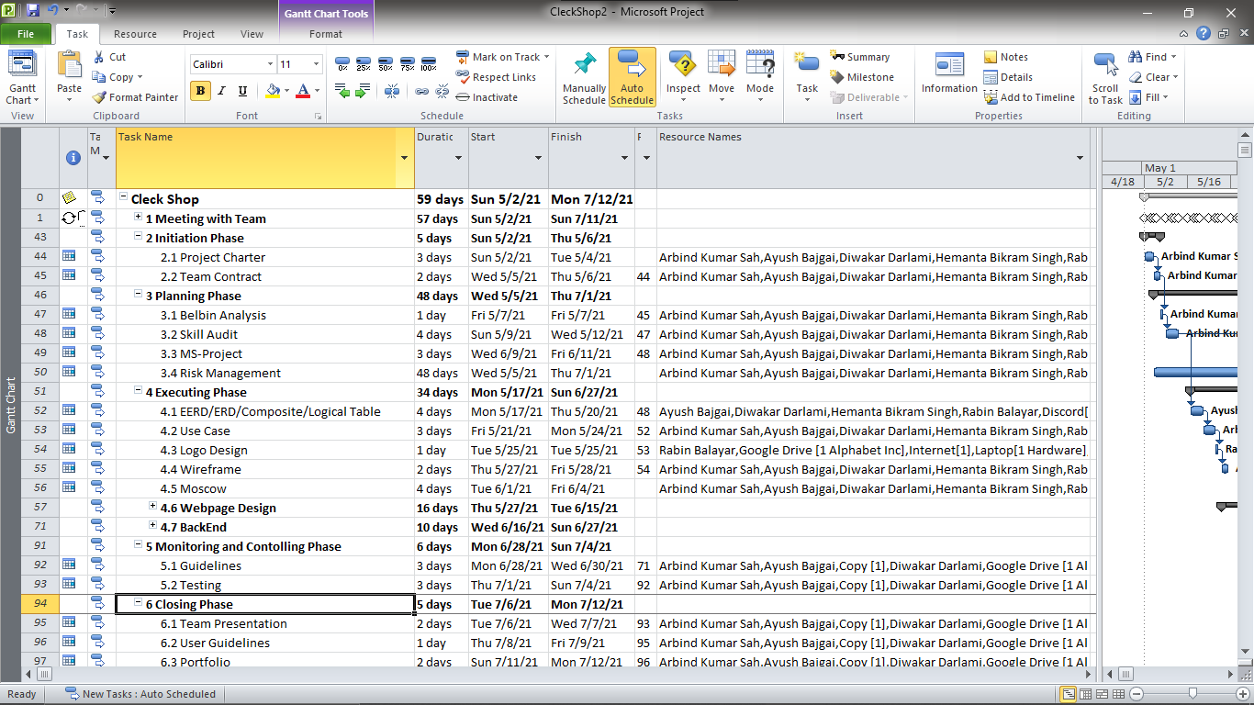
Work Breakdown Structure

Slide 33
Product Progression

Slide 34

Login

Slide 35
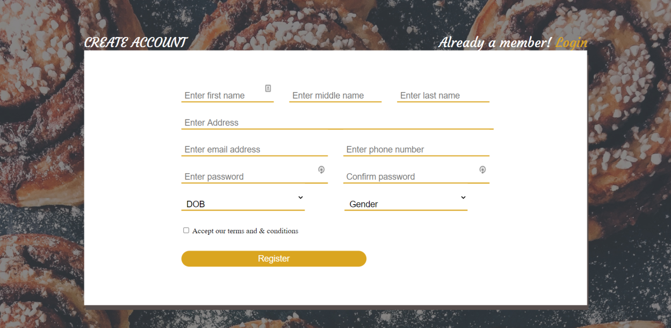
Register

Slide 36
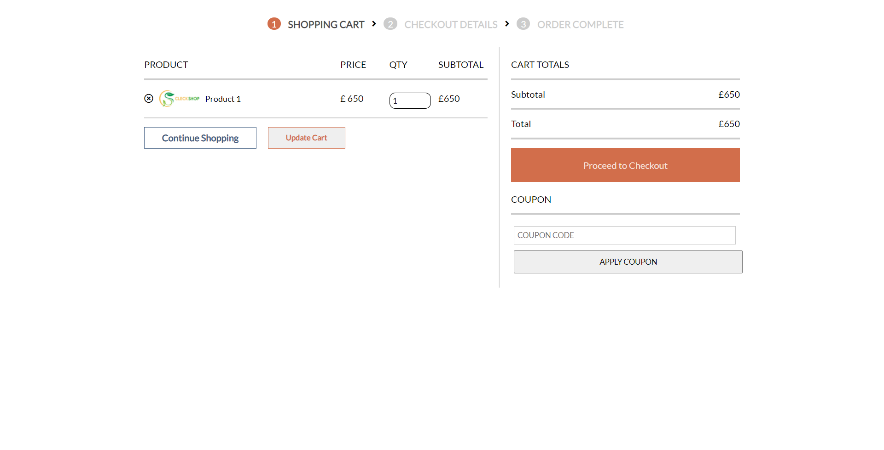
Cart

Slide 37
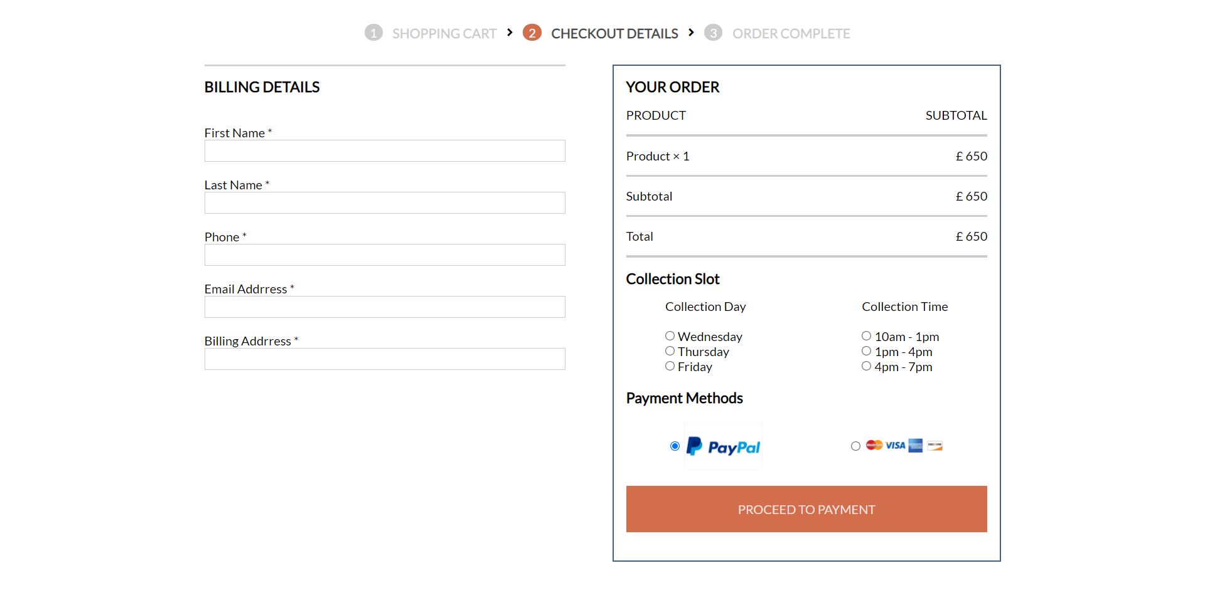
Checkout

Slide 38
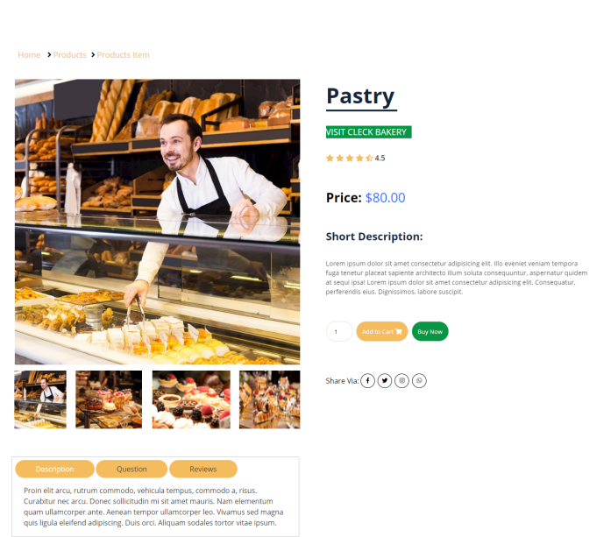
Product

Slide 39
Conclusion

Slide 40


Slide 41
Thank You

